Slide 1
HTML - Session - 3
HTML Id and Class
Block and Inline Elements
Images
Links
Notes:
Today we are going to cover four main topics.

Slide 2
HTML Id and Class

Slide 3
HTML Id
The HTML id attribute is used to specify a unique id for an HTML element.
The syntax for id is:
write a hash character (#) for accessing.
followed by an id name.
<h1 id=”myheader”>
You cannot have more than one element with the same id in an HTML document.
The id name is case sensitive
The id name must contain at least one character, and must not contain whitespaces
Notes:
The id attribute is used to point to a specific style declaration in a style sheet. It is also used by JavaScript to access and manipulate the element with the specific id.
https://www.w3schools.com/html/html_id.asp

Slide 4
HTML Class
The HTML class attribute is used to specify a class for an HTML element.
The syntax for class is:
write a dot character(.) for accessing.
followed by a class name.
<h1 class=”city”>
Multiple HTML elements can share the same class.
The class name is case sensitive
The class attribute can be used on any HTML element.
Notes:
The class attribute is often used to point to a class name in a style sheet. It can also be used by a JavaScript to access and manipulate elements with the specific class name.
https://www.w3schools.com/html/html_classes.asp

Slide 5
HTML Block and Inline Elements
Notes:
Every HTML element has a default display value, depending on what type of element it is.
There are two display values: block and inline.

Slide 6
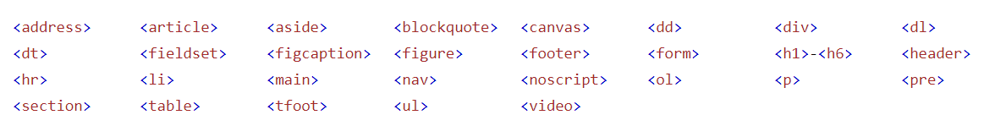
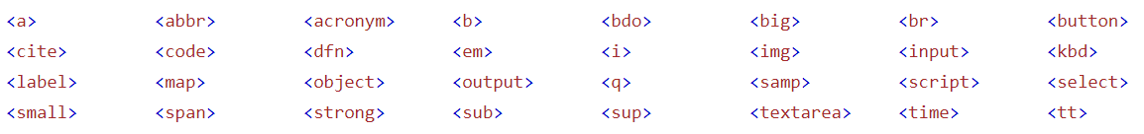
Block Level
Inline Level
A Block-level element occupies the entire horizontal space of its parent element (container), and vertical space equal to the height of its contents, thereby creating a "block".
Browsers typically display the block-level element with a newline both before and after the element.
Inline elements are those which only occupy the space bounded by the tags defining the element, instead of breaking the flow of the content.
An inline element does not start on a new line and only takes up as much width as necessary.

Slide 7
Div Element
Span Element
The <div> element is often used as a container for other HTML elements.
The <div> element has no required attributes, but style, class and id are common.
When used together with CSS, the <div> element can be used to style blocks of content
The <span> element is an inline container used to mark up a part of a text, or a part of a document.
The <span> element has no required attributes, but style, class and id are common.
When used together with CSS, the <span> element can be used to style parts of the text.

Slide 8
HTML Images
Notes:
There are many reasons why you might want to add an image to a web page: you might want to include a logo, photograph, illustration, diagram, or chart. There are several things to consider when selecting and preparing images for your site, but taking time to get them right will make it look more attractive and professional.

Slide 9

“alt” is one of the HTML image attributes.
Notes:
🍐 This is a Pear Deck Multiple Choice Slide. Your current options are: A: False, B: True,
🍐 To edit the type of question or choices, go back to the "Ask Students a Question" in the Pear Deck sidebar.

Slide 10
Table of Contents
<img> Tag
The alt Attribute
The weight and height Attribute
The Border Attribute

Slide 11
<img> Tag
1
Notes:
A picture can say a thousand words, and great images help make the difference between an average-looking site and a really engaging one.

Slide 12
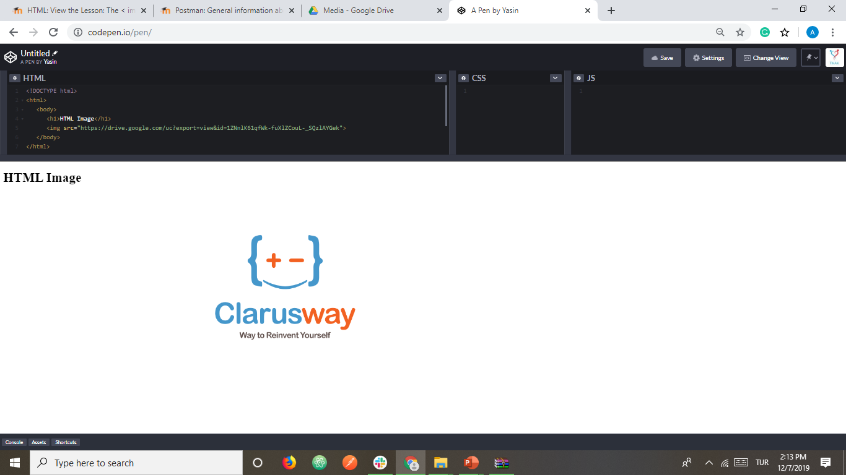
<img> Tag
We can improve the design of a web page by adding images
The <img> tag is used to define an image
The <img> tag is empty. It means that it does not have a closing tag
The src attribute tells the browser where it can find the image file and it is mandatory.
Notes:
If you are building a site from scratch, it is good practice to create a folder for all of the images the site uses. Use different folder options

Slide 13
The alt Attribute
2

Slide 14
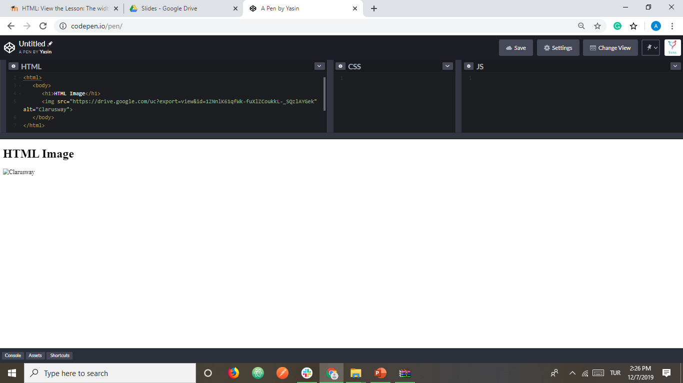
The alt Attribute
The alt attribute is used to provide an alternate text for an image in case the image fails to load on a web page or it is not supported by the browser, etc.
Moreover, Visually impaired users browse the web via screen reading software. The screen reading software can read the text inside an alt attribute for impaired users.
We should add alt attribute to the image tag just like the src attribute.

Slide 15
The width and height Attribute
3

Slide 16

The width and height Attributes
The width and height attributes are used to resize images.
Notes:
The width and height attributes always define the width and height of the image in pixels. The width, height, and style attributes are all valid in HTML.
However, we suggest using the style attribute. It prevents styles sheets from changing the size of images

Slide 17
The border Attribute
4

Slide 18

The border Attribute
* By default, an image has no borders.
* To add a border around the image, we can use border attribute.

Slide 19

Using Images in Your Pages

Slide 20


Slide 21
HTML Links
Notes:
Links are found in nearly all web pages. Links allow users to click their way from page to page.
HTML links are hyperlinks.
You can click on a link and jump to another document.
When you move the mouse over a link, the mouse arrow will turn into a little hand.

Slide 22
HTML links starts with <alt> tag.
Notes:
🍐 This is a Pear Deck Multiple Choice Slide. Your current options are: A: True, B: False,
🍐 To edit the type of question or choices, go back to the "Ask Students a Question" in the Pear Deck sidebar.

Slide 23
Table of Contents
<a> Tag
The href Attribute
The target Attribute
Image as a Link

Slide 24
<a> Tag
1

Slide 25
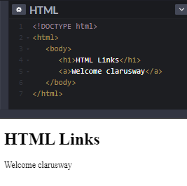
<a> Tag
One of the advantages of HTML, is the ability to link to other web pages
The <a> element and including text/image is used to define a link

Slide 26
The href Attribute
2

Slide 27
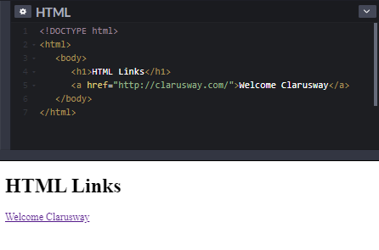
The href Attribute
Technically, we didn't complete the HTML link
We need href attribute inside opening <a> tag to specify which page we want to link
The href attribute defines the address of the link
Hypertext REFerence
Notes:
The most important attribute of the <a> element is the href attribute, which indicates the link's destination.
By default, links will appear as follows in all browsers:
An unvisited link is underlined and blue
A visited link is underlined and purple
An active link is underlined and red

Slide 28
The target Attribute
3

Slide 29

The target Attributes
The target attribute is used to specify how a link should open
The width and height attributes are used to resize images.
In order to open link in a new page, the target attribute requires a value of _blank
We should add the target attribute inside opening <a> tag like href attribute

Slide 30



HTML Link Colors
An unvisited link is underlined and blue
The width and height attributes are used to resize images.
A visited link is underlined and purple
An active link is underlined and red

Slide 31
Image as a Link
4

Slide 32
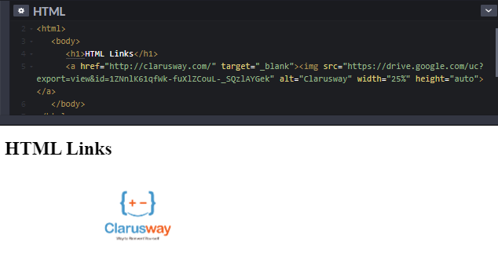
Image as a Link
* We can use an image as a link in HTML
* For this, it is enough to put an <img> tag between opening and closing <a> tag

Slide 33
Create Bookmarks
HTML links can be used to create bookmarks, so that readers can jump to specific parts of a web page.
When the link is clicked, the page will scroll down or up to the location with the bookmark.
First, use the id attribute to create a bookmark, Then, add a link to the bookmark ("Jump to Chapter 4"), from within the same page
Notes:
https://www.w3schools.com/html/html_links_bookmarks.asp

Slide 35
Do you need a review?
if so: which section?
Notes:
🍐 This is a Pear Deck Multiple Choice Slide. Your current options are: A: NO, B: Formatting Elements, C: Lists, D: Tables, E: Images, F: Links,
🍐 To edit the type of question or choices, go back to the "Ask Students a Question" in the Pear Deck sidebar.

Slide 36
THANKS!
Any questions?

